Slide 1
Linear Bounded Automata
LBAs

Slide 2
Linear Bounded Automata (LBAs)
are the same as Turing Machines
with one difference:
The input string tape space
is the only tape space allowed to use

Slide 3







Linear Bounded Automaton (LBA)
Input string
Working space
in tape
Left-end
marker
Right-end
marker
All computation is done between end markers

Slide 4
We define LBA’s as NonDeterministic
Open Problem:
NonDeterministic LBA’s
have same power with
Deterministic LBA’s ?

Slide 5
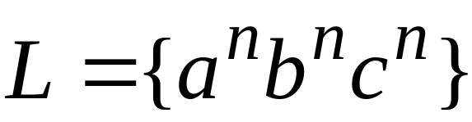
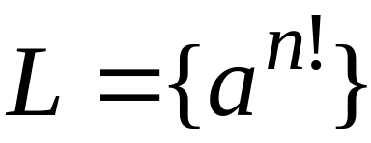
Example languages accepted by LBAs:
Conclusion:
LBA’s have more power than NPDA’s

Slide 6
Later in class we will prove:
LBA’s have less power
than Turing Machines

Slide 7
A Universal Turing Machine

Slide 8
A limitation of Turing Machines:
Turing Machines are “hardwired”
they execute
only one program
Real Computers are re-programmable

Slide 9
Solution:
Universal Turing Machine
Attributes:
Reprogrammable machine
Simulates any other Turing Machine

Slide 10

Universal Turing Machine
simulates any other Turing Machine
Input of Universal Turing Machine:
Description of transitions of
Initial tape contents of

Slide 11
Tape 1
Three tapes
Description of
Universal
Turing
Machine
Tape 2
Tape Contents of
Tape 3
State of

Slide 12
Tape 1
Description of
We describe Turing machine
as a string of symbols:
We encode as a string of symbols

Slide 13








Alphabet Encoding
Symbols:
Encoding:

Slide 14






State Encoding
States:
Encoding:
Head Move Encoding
Move:
Encoding:

Slide 15
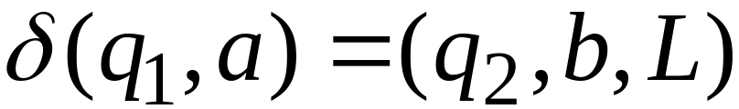
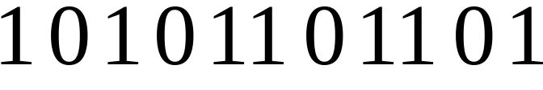
Transition Encoding
Transition:
Encoding:
separator

Slide 16
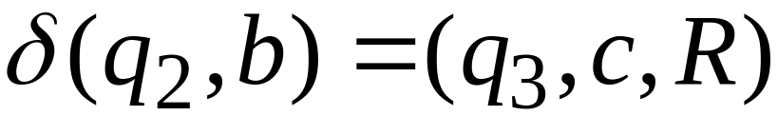

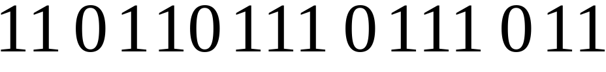
Machine Encoding
Transitions:
Encoding:
separator

Slide 17
Tape 1 contents of Universal Turing Machine:
encoding of the simulated machine
as a binary string of 0’s and 1’s

Slide 18
A Turing Machine is described
with a binary string of 0’s and 1’s
Therefore:
The set of Turing machines forms a language:
each string of the language is
the binary encoding of a Turing Machine

Slide 19
Language of Turing Machines
L = { 010100101,
00100100101111,
111010011110010101,
…… }
(Turing Machine 1)
(Turing Machine 2)
……

Slide 20
Countable Sets

Slide 21
Infinite sets are either:
Countable
or
Uncountable

Slide 22
Countable set:
There is a one to one correspondence
between
elements of the set
and
positive integers

Slide 23
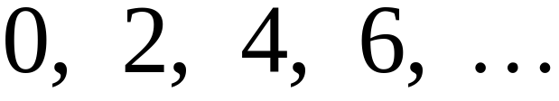
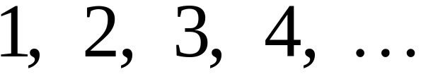


Example:
The set of even integers
is countable
Even integers:
Correspondence:
Positive integers:
corresponds to

Slide 24
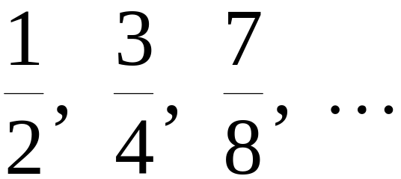
Example:
The set of rational numbers
is countable
Rational numbers:

Slide 25
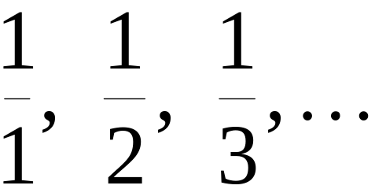
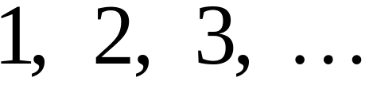
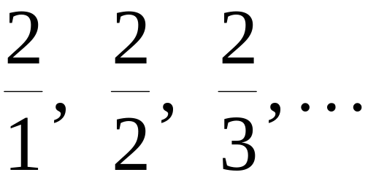
Naïve Proof
Rational numbers:
Correspondence:
Positive integers:
Doesn’t work:
we will never count
numbers with nominator 2:

Slide 26










Better Approach

Slide 32
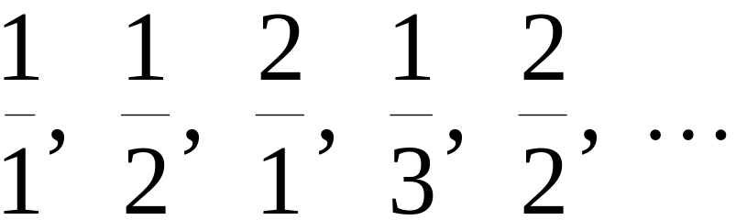
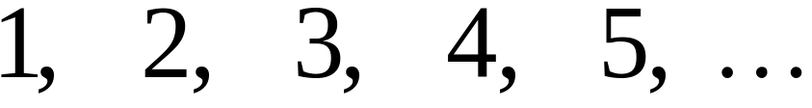
Rational Numbers:
Correspondence:
Positive Integers:

Slide 33
We proved:
the set of rational numbers is countable
by describing an enumeration procedure

Slide 34

Definition
Let be a set of strings
An enumeration procedure for is a
Turing Machine that generates
all strings of one by one
and
Each string is generated in finite time

Slide 35
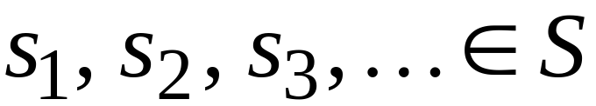
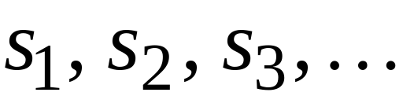

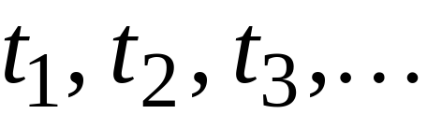
strings
Enumeration
Machine for
output
(on tape)
Finite time:

Slide 36







Enumeration Machine
Configuration
Time 0
Time

Slide 37






Time
Time

Slide 38
Observation:
A set is countable if there is an
enumeration procedure for it

Slide 39
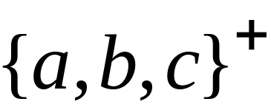
Example:
The set of all strings
is countable
Proof:
We will describe the enumeration procedure

Slide 40



Naive procedure:
Produce the strings in lexicographic order:
Doesn’t work:
strings starting with
will never be produced

Slide 41
Better procedure:
Proper Order
1. Produce all strings of length 1
2. Produce all strings of length 2
3. Produce all strings of length 3
4. Produce all strings of length 4
..........

Slide 42















length 1
Produce strings in
Proper Order:
length 2
length 3

Slide 43
Theorem:
The set of all Turing Machines
is countable
Proof:
Any Turing Machine can be encoded
with a binary string of 0’s and 1’s
Find an enumeration procedure
for the set of Turing Machine strings

Slide 44
Enumeration Procedure:
Repeat
1. Generate the next binary string
of 0’s and 1’s in proper order
2. Check if the string describes a
Turing Machine
if YES: print string on output tape
if NO: ignore string

Slide 45
Uncountable Sets

Slide 46
Definition:
A set is uncountable
if it is not countable

Slide 47
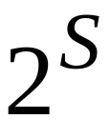
Theorem:
Let be an infinite countable set
The powerset of is uncountable

Slide 48
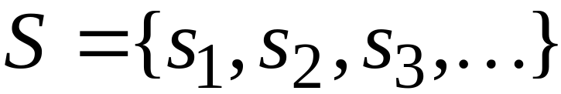
Proof:
Since is countable, we can write
Elements of

Slide 49
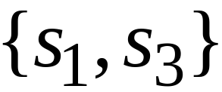
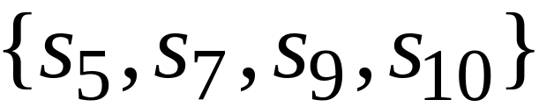
Elements of the powerset have the form:
……

Slide 50




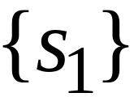

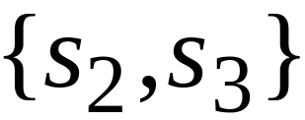
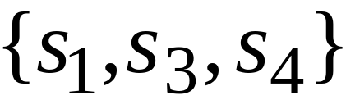
We encode each element of the power set
with a binary string of 0’s and 1’s
Encoding
Powerset
element

Slide 51
Let’s assume (for contradiction)
that the powerset is countable.
Then: we can enumerate
the elements of the powerset

Slide 52




Powerset
element
Encoding

Slide 53
Take the powerset element
whose bits are the complements
in the diagonal

Slide 54

New element:
(birary complement of diagonal)

Slide 55

The new element must be some
of the powerset
However, that’s impossible:
from definition of
the i-th bit of must be
the complement of itself
Contradiction!!!

Slide 56
Since we have a contradiction:
The powerset of is uncountable

Slide 57
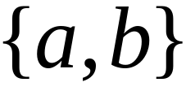
An Application: Languages
Example Alphabet :
The set of all Strings:
infinite and countable

Slide 58
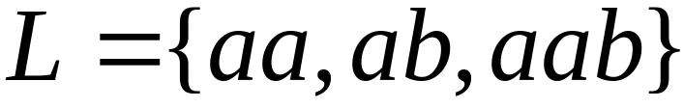
Example Alphabet :
The set of all Strings:
infinite and countable
A language is a subset of :

Slide 59




Example Alphabet :
The set of all Strings:
infinite and countable
The powerset of contains all languages:
uncountable

Slide 60



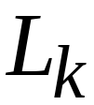
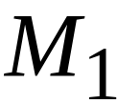
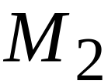
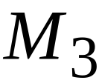

Languages: uncountable
Turing machines: countable
There are infinitely many more languages
than Turing Machines

Slide 61
Conclusion:
There are some languages not accepted
by Turing Machines
These languages cannot be described
by algorithms

